Slide 1
ML for Selecting Electrolytes
“SELEC” Machine Learning Models
03/15/2022
Shuyan Zhao
Bella Wu
Karen Li
Rose Lee
Notes:
names → UI → ML

Slide 2
Project Motivation
Electrolyte research is a hot topic
Input combination of 3 variables (cathode, anode, C-rate)
Program predicts battery performance and selects best electrolyte
Cathode
Electrolyte
Anode
Notes:
battery eli5 → program fn → audience is rnd

Slide 3
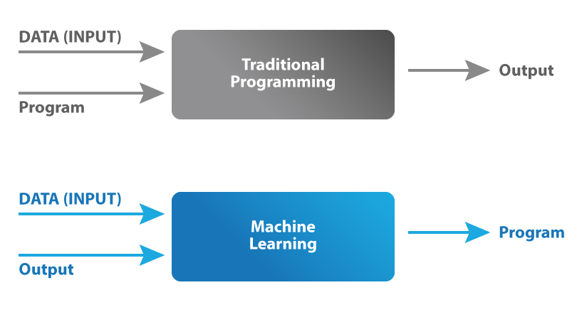
Why machine learning
Machine Learning = Categorization + Prediction
Notes:
audience is rnd → python scary uwu → ez interface

Slide 4
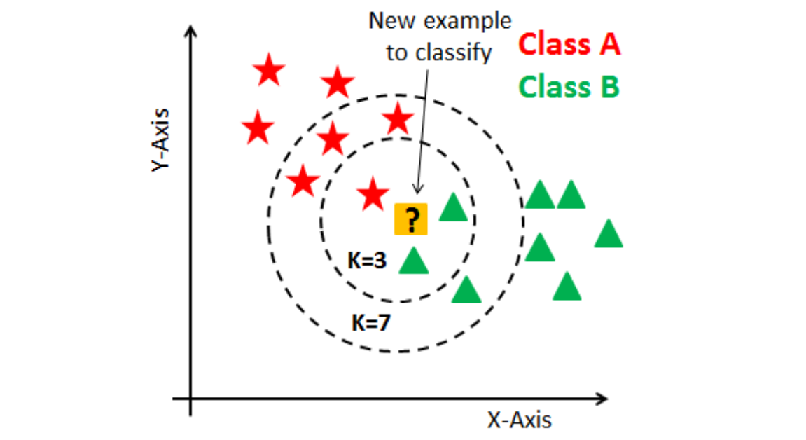
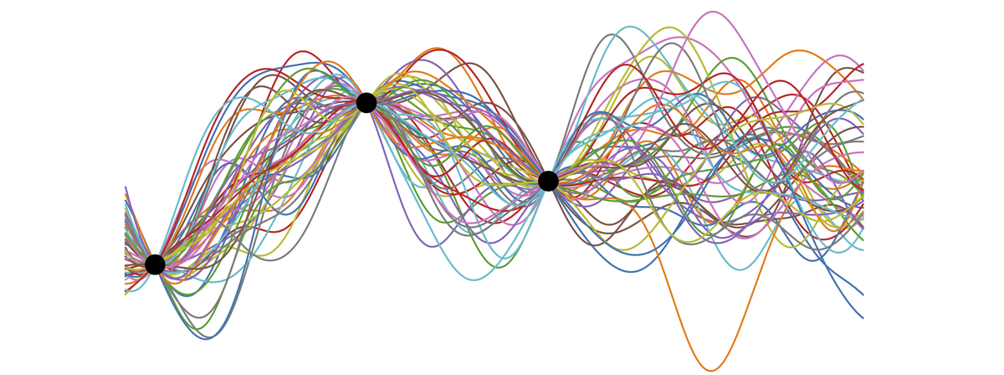
Machine Learning Regressors
K-nn
Easy to understand and implement
Evolves with new training data
Decision tree
No normalization of data
Sensitive & No model-assumption needed
Gaussian Process
Nonlinear regression, Can return probability of fit (how well it thinks it predicted data) which would have been beneficial for predicting data in the design space
Random Forest
Implicitly perform feature selection and generate uncorrelated decision trees
Low outlier interference
Support Vector
Effective in multidimensional model
Able to give accurate margin when less overlapping data is given
Gradient Boosting
Reduces bias error
Optimize different loss functions and several hyperparameter tuning options

Slide 5
Comparison
Red number is the average MSE of y_training to y_validation
Black number is MSE of y_predicted to y_test
Regressor | Hyper parameters | Charge Capacity (ah) | Discharge Capacity (ah) | Charge Energy (Wh) | Discharge Energy (Wh) | Coulombic Efficiency (%) | Energy Efficiency (%)
k-NN | KNN_model_train =KNeighborsRegressor(n_neighbors=10) | 0.54450 0.52807 | 0.54300 0.52947 | 2.09661 2.06256 | 1.86602 1.81431 | 0.61850 1.36781 | 2.25484 2.72823
Decision Tree | DecisionTree_model =DecisionTreeRegressor(random_state = 66) | 0.67986 0.74145 | 0.67835 0.74332 | 2.60967 2.87890 | 2.34078 2.58702 | 0.88036 1.36698 | 2.00336 2.96019
Random Forest | RF_model_Capacity =RandomForestRegressor(n_estimators=666,min_samples_split=5, max_depth=7,min_samples_leaf=1,random_state = 66) | 0.57817 0.59187 | 1.75041 1.34072 | 2.21882 2.30451 | 1.98312 2.00897 | 0.64437 1.36248 | 1.75041 2.40429
Support Vector | svm_model_optimal =SVR(kernel ='rbf',gamma=0.03393221771895328,C=387) | 0.49200 0.58212 | 0.49135 0.58391 | 1.85625 2.00114 | 1.67725 1.80330 | 1.34071 0.4726 | 1.56434 2.63053
Gaussian Process | kernel = DotProduct() + WhiteKernel() gpr = GaussianProcessRegressor(kernel=kernel, random_state=66) | 0.57402 0.58312 | 0.57266 0.58302 | 2.22092 2.31055 | 1.91589 1.91545 | 0.56007 1.33870 | 3.39670 3.96112
Gradient Boosting | max_depth=3, n_estimators=4369, min_samples_leaf=1, min_samples_split=2, max_features=7, learning_rate=0.049, random_state = 66) | 0.78653 0.69459 | 0.785340 0.691265 | 3.02293 2.68408 | 2.69563 2.40398 | 0.22130 1.37155 | 1.55026 2.71899

Slide 6
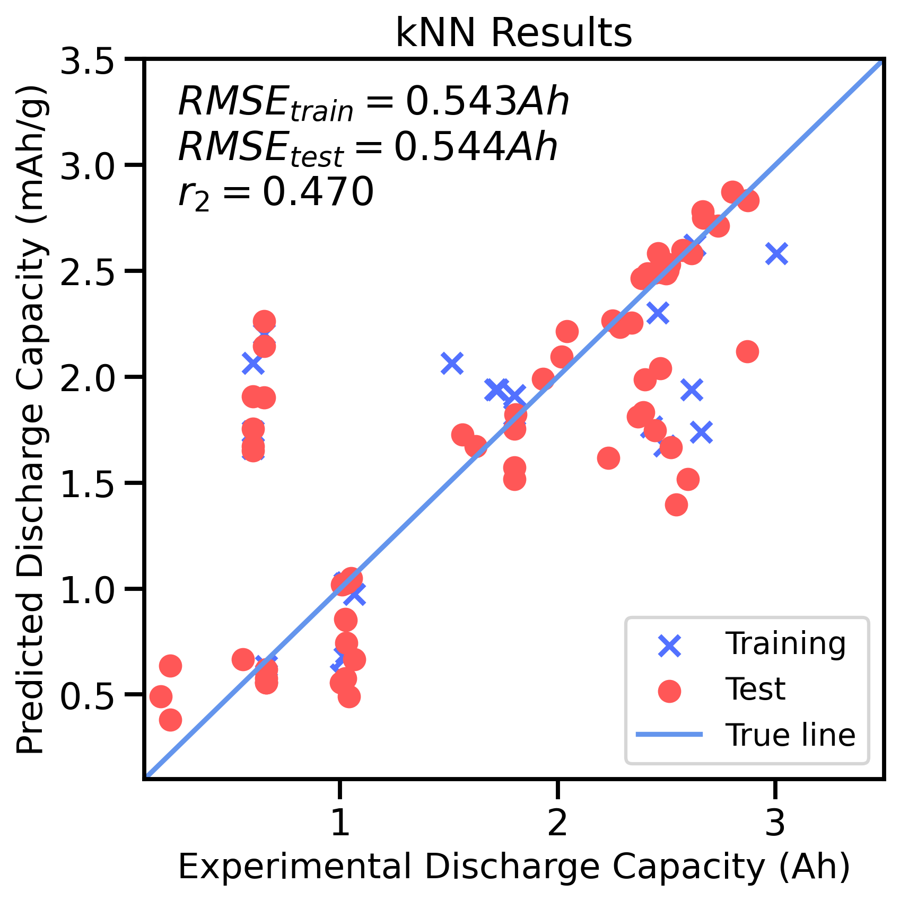
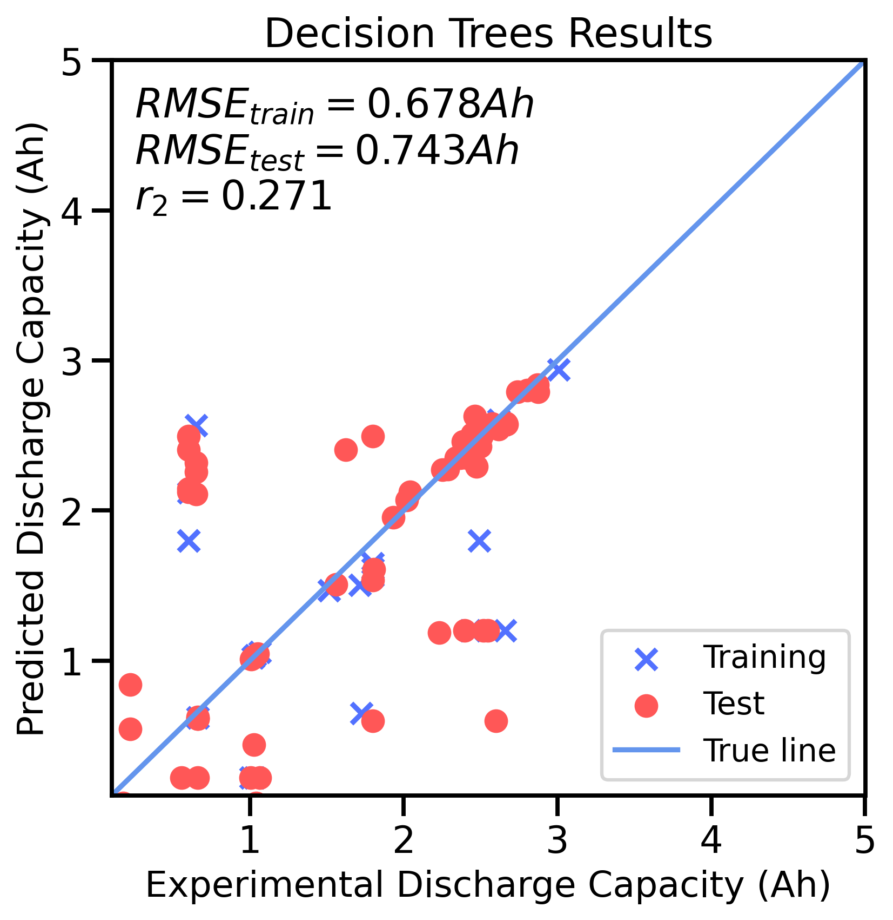
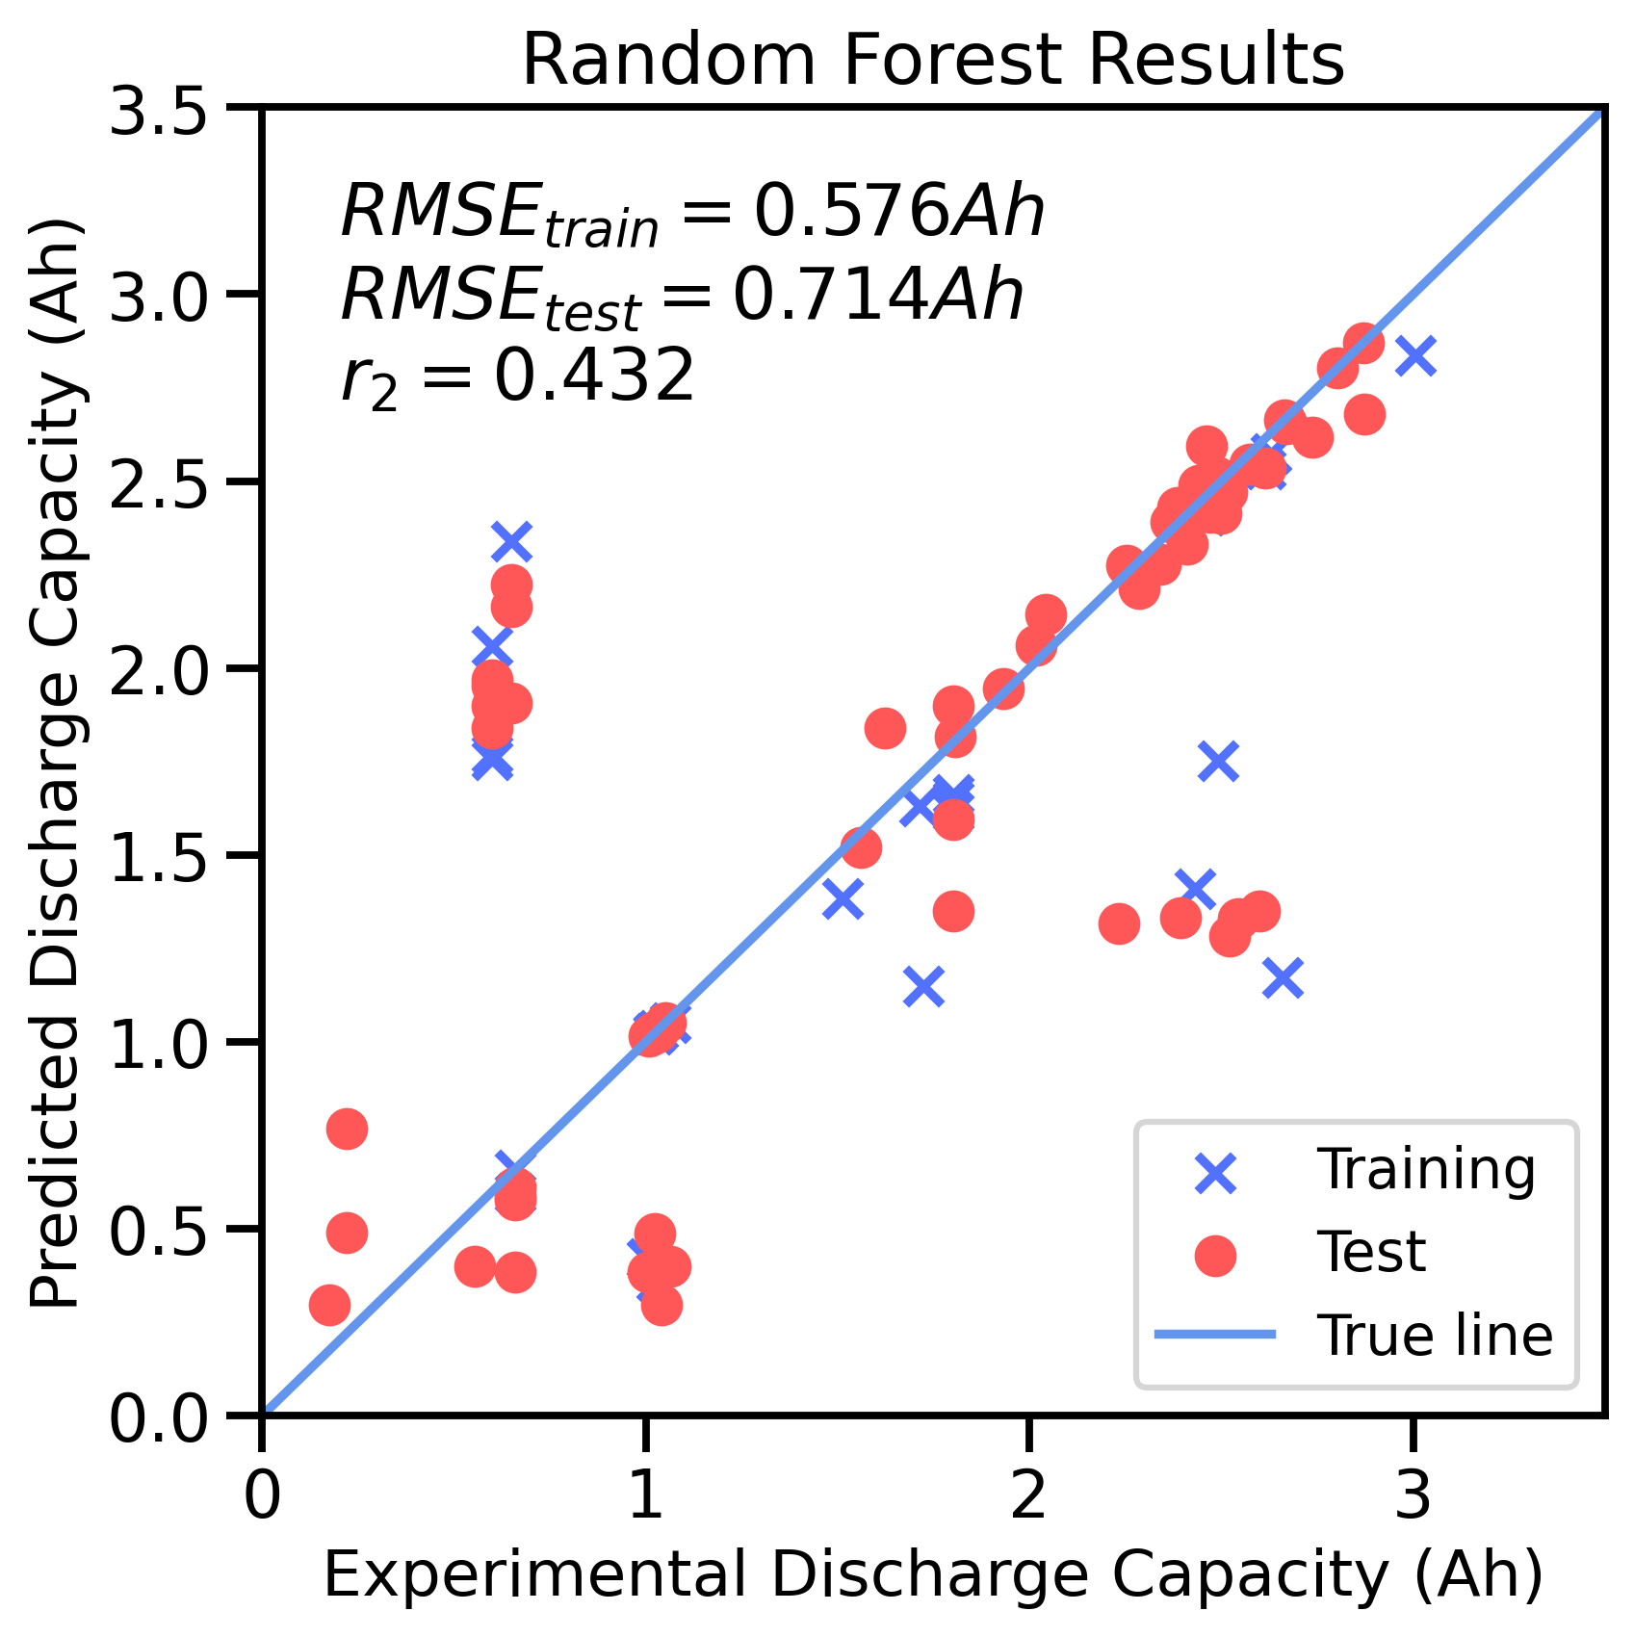
Comparison

Slide 7
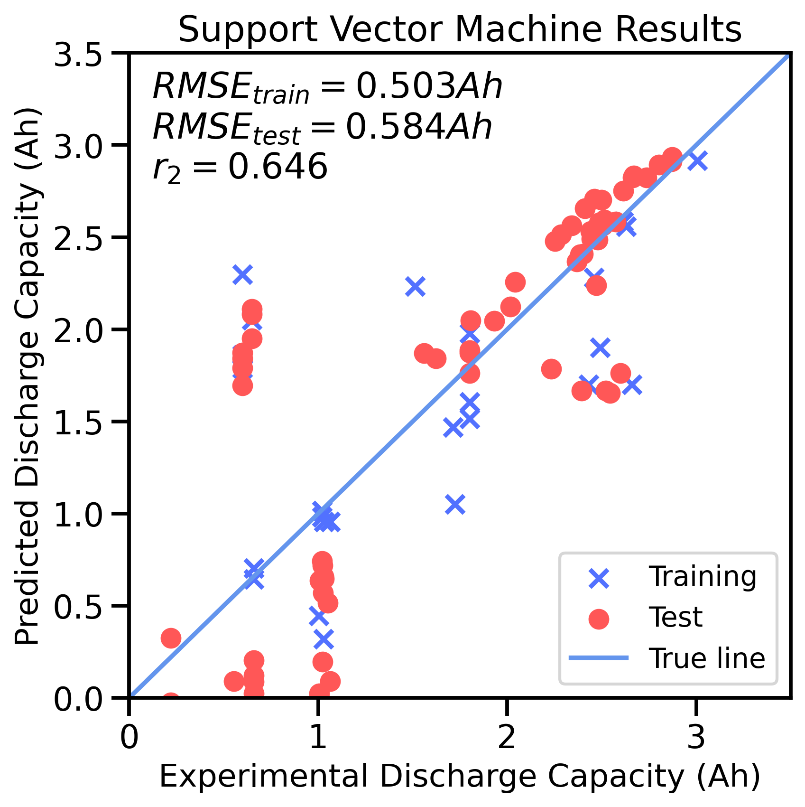
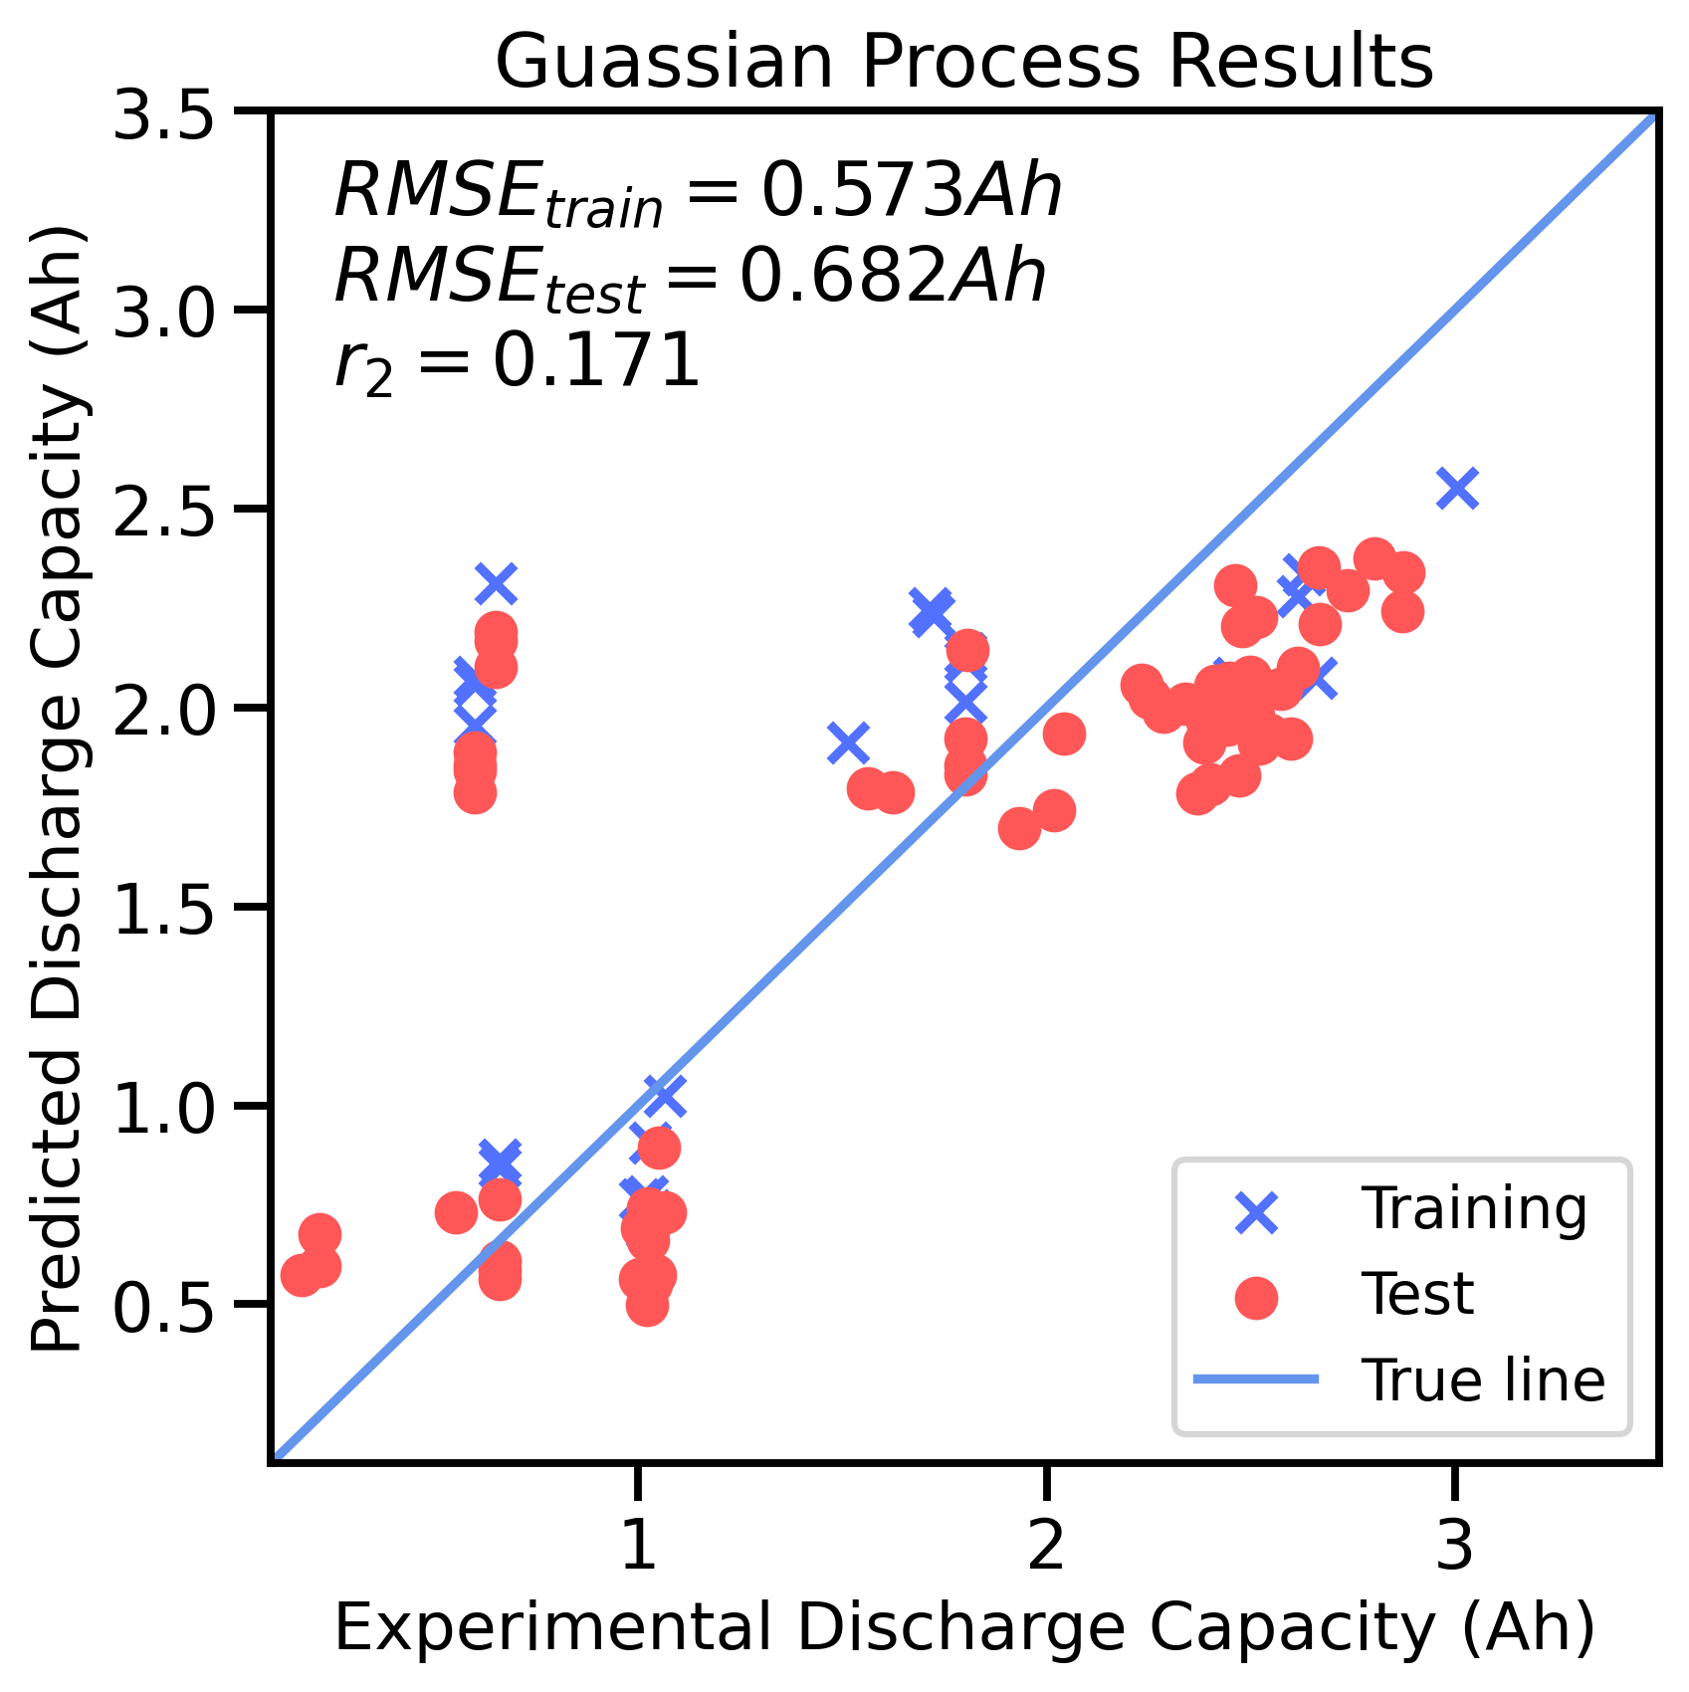
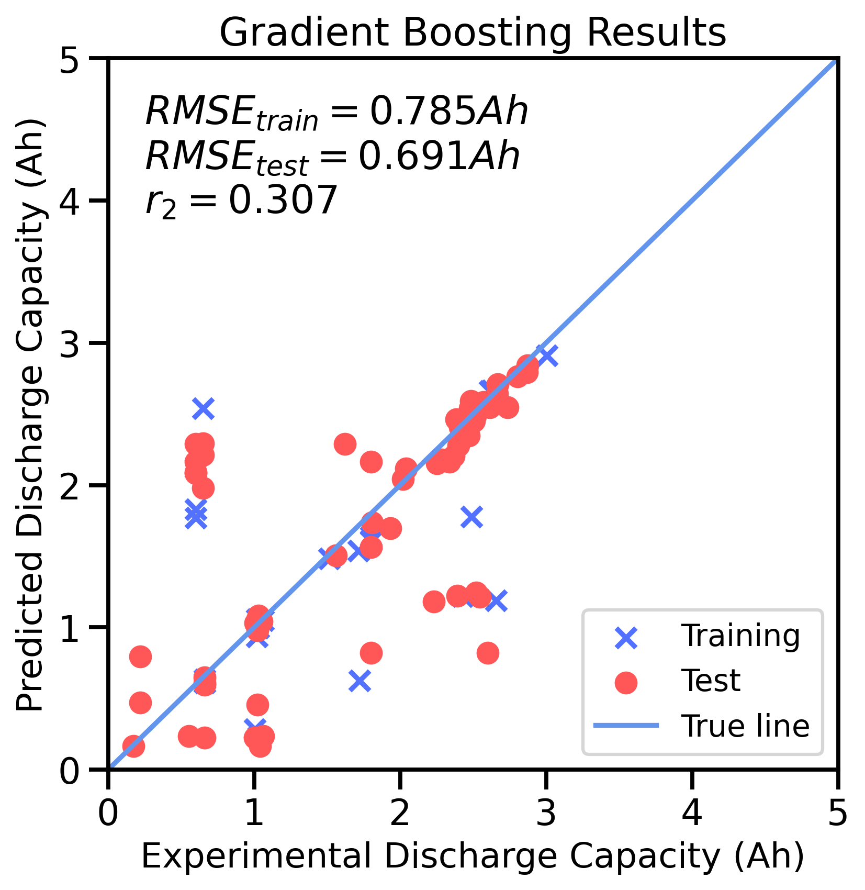
Comparison

Slide 8
k - Nearest Neighbor
K-NN showed the best result for most performance metric
Most validation RMSE and test RMSE are similar, not overfitting
Result for coulombic efficiency have a higher loss value for test perhaps due to high variance
Used GridSearchCV to find the best hyperparameters for each metric
Validation MSE and test MSE are similar, not overfitting
k-NN Regression | Charge Capacity (Ah) | Discharge Capacity (Ah) | Charge Energy (Wh) | Discharge Energy (Wh) | Coulombic Efficiency (%) | Energy Efficiency (%)
Hyper parameters | algorithm: auto n_neighbors: 11 weights: uniform | algorithm: auto n_neighbors: 11 weights: uniform | algorithm: auto n_neighbors: 11 weights: uniform | algorithm: auto n_neighbors: 12 weights: uniform | algorithm: ball_tree n_neighbors: 46 weights: uniform | algorithm: auto n_neighbors: 4 weights: uniform
Validation RMSE | 0.54409 | 0.54247 | 2.09695 | 1.85681 | 0.52016 | 2.14238
Test RMSE | 0.53789 | 0.53901 | 2.10426 | 1.85810 | 1.37176 | 2.89146

